Slide 1

Low Back Pain: The Silent Epidemic
John Kolich, 325526
Colorado State University Global
MIS581: Capstone - Business Intelligence and Data Analytics
Dr. Steve Chung
May 14, 2023

Slide 2
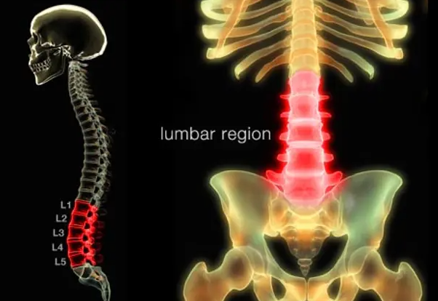
Overview
Reasons to Study Low Back Pain (LBP)
Nearly ubiquitous
Expensive
Dangerous, maybe
Multi-causal, multi-disciplined
Note: From WebMD, 2023 (https://www.webmd.com/back-pain/ss/slideshow-low-back-pain-overview)
Notes:
LBP is a nearly ubiquitous concern in developed countries. The incidence rate is 84% worldwide, and of those cases, 85% are what is known as non specific low back pain. Definitions are important in this regard, as the focus of this research is not applicable to cases with a definitive cause such as cancer, fracture, or other gross spinal lesion (Salzberg & Manusov, 2013).
LBP is a heavy financial burden on both patients and healthcare systems. The average cost of a common low back surgeries ranges from $17,400 - $36,880 (Poslusny, 2021). These costs should be reserved by patients who have exhausted all other
An important consideration for those who have not experienced LBP, is that, typically, the severity of pain and disability is disproportionate to the amount of danger the patient is in. In other words, the pain makes patients feel like something is terribly wrong, which is usually not the case. The symptoms may lead them to jump into more invasive care, which does carry non-zero risk of worsening the pain, paralysis, to death. Conservative treatment is unlikely to progress nonspecific low back pain (Hall et al, 2021).
Diagnosis and treatment of LBP concerns a wide range of practitioners who are all interested in preserving their field of work. The patient must be prioritized in the decision-making process and not goaded into making a potentially life altering decision because they are in severe pain.

Slide 3
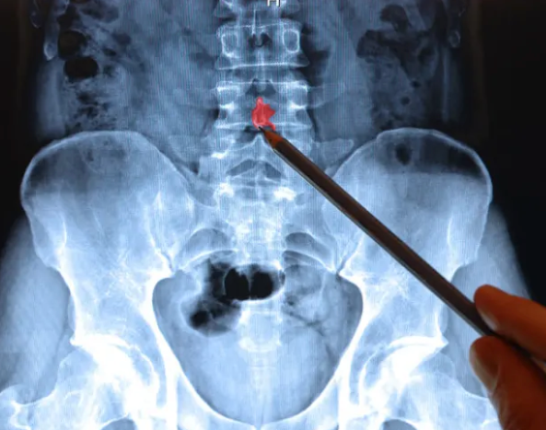
Literature Review
Medical Imaging
Over 90% of LBP has no obvious cause
Incidental findings result in poorer patient outcomes
Risk to Patient
79% of five-year surgical outcomes are “good”
24% require re-operation
Multi-practitioner solutions are effective, but unavailable
Note: From HealthCentral, 2023 (https://www.healthcentral.com/condition/back-pain/low-back-pain/do-really-need-ray-or-mri-lower-back-pain)
Notes:
The majority of LBP does not have an obvious cause. For that reason, medical imaging, mostly X-Ray and MRI are not indicated as a preliminary diagnosis tool. In fact, incidental findings such as bone spurs or disc degeneration cause patients to believe they are injured and therefore results in poorer outcomes, to include longer healing times (Hall, 2021).
Along with the risks associated with surgical treatment, the results are not guaranteed. 79% of patients report “good” on a 5-point Likert scale 5 years post-operation. Typically, if the surgery reduces pain immediately, then it will have successful long term outcomes. Of concern are the 24% who require re-operation, which nearly always has poor outcomes (Mannion et al, 2010).
Positive results are seen in multi-practitioner solutions that include therapists, coaches and/or psychologists. Unfortunately, these teams are rare in the economy and tend to exists only in research (Rainville et al, 2009).

Slide 4
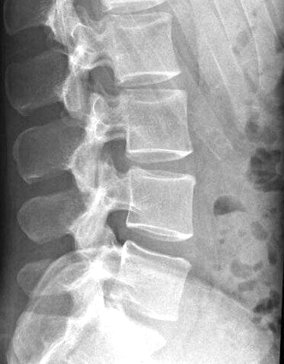
Dataset
Dataset
310 observations
13 spinal measurement attributes
1 target classification variable
Patient in pain, or not in pain
Note: From Sportsmedreview, 2023 (https://www.sportsmedreview.com/blog/a-review-on-reading-lumbar-x-rays/)
Notes:
The data for the research is taken from Kaggle.com. It contains 310 observations of 13 continuous measured spinal angles, and 1 target classification variable. The target variable indicates whether or not the patient is experiencing pain. Spinal measurements include pelvic incidence, pelvic tilt, lumbar lordosis angle, sacral slope, pelvic radius, degree spondylolisthesis, pelvic slope, direct tilt, thoracic slope, cervical tilt, sacrum angle, and scoliosis slope.

Slide 5



Methods - Software
SAS
Summary statistics
Hypothesis testing
Excel
Data transformation
Python
Producing models and visualizations
Notes:
Three software tools are used in the course of this research. The dataset is an excel comma separated values document that is initially uploaded into SAS for summary statistics. SAS easily performs these tasks with limited coding ability as the software generates the majority of code through a graphical user interface. The hypothesis testing is performed in SAS as well.
Excel is mostly used to store the downloaded data from Kaggle. Of note, transformation tasks, since they were minor, occurred in the Excel file.
Python, specifically the Pandas and Seaborn libraries, is are used to produce models and visualizations of transformed data

Slide 6
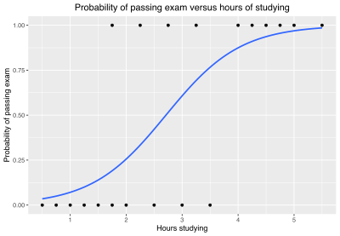
Methods - Models
Logistic Regression
Variable selection
Hypothesis testing
Decision Tree Classifier
Random Forest
Note: Wikipedia, 2023 (https://en.wikipedia.org/wiki/Logistic_regression)
Notes:
Three classification models are selected. Logistic regression is firstly used in SAS to perform stepwise variable selection with alpha levels set at 0.05. If significant variables are left after this selection, then the null hypothesis may be rejected.
Decision tree classifier and random forest will then be assessed for accuracy to determine if an accurate predictive model can be established.

Slide 7
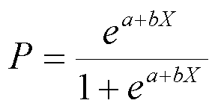
Hypotheses
H0: Anatomical measurements do not have an effect on patient symptoms: bspinal_measurements = 0
Ha: Anatomical measurements do have an effect on patient symptoms: bspinal_measurements <> 0
Put simply: Do the 13 spinal measurements from the dataset significantly influence whether a patient is experiencing pain?
If so, do what degree, and of what magnitude?
Note: Logistic Regression Formula, Wikipedia, 2023 (https://en.wikipedia.org/wiki/Logistic_regression)
Notes:
The hypothesis tested is whether the variables in the dataset demonstrate a p-value less than 0.05 when passed through a logistic regression. This is not only used to test hypotheses, but also to reduce variables. Once significant variables are determined, their magnitude may be measured through the selected models.

Slide 8
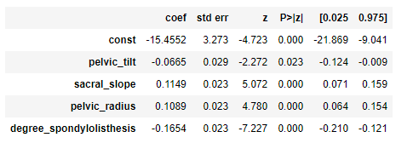
Analysis – Hypotheses Testing
Notes:
These results demonstrate the SAS output for logistic regression targeting patient pain at a 0.05 alpha. The model successfully reduced the variable size from 13 to 4. Pelvic tilt and degree spondylolisthesis appear to reduce the likelihood a patient will experience pain as they increase. In contrast, sacral slope and pelvic radius increase the likelihood to categorize pain. The determination to categorize pain is based on values greater than 0.50.

Slide 9
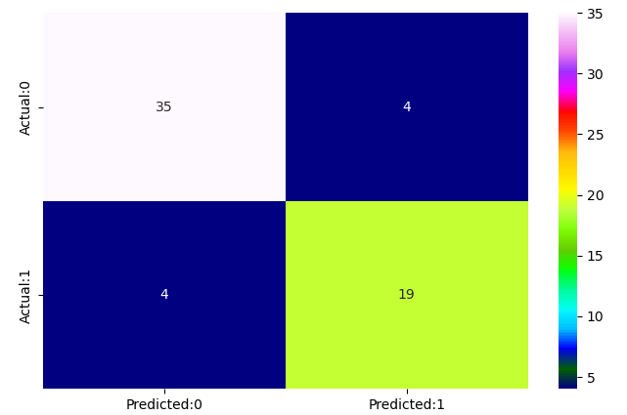
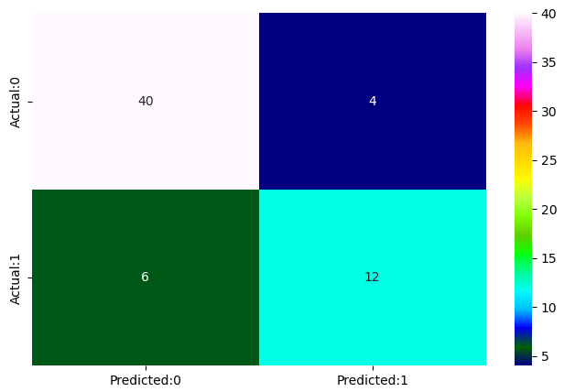
Findings
Logistic Regression | Decision Tree Classifier | Random Forest
87% | 84% | 87%
Logistic Regression/Random Forest
Decision Tree Classifier
Notes:
Logistic regression and random forest perform equally at 87% accurate, where decision tree classifier predicted at 84% accuracy. These results are taken from an 80/20 train to test split in the data. Logistic regression and random forest correctly identify 54 of 62 observations, with 4 false positives and 4 false negatives. Decision tree correctly classified 52, with 4 false positives and 6 false negatives.

Slide 10
Limitations
Does not provide holistic view
Only one piece of a large puzzle
Spinal measurements may be altered by pain
Not causative
Note: From Sportsmedreview, 2023 (https://www.sportsmedreview.com/blog/a-review-on-reading-lumbar-x-rays/)
Notes:
The Spine dataset is limited to testing whether spinal measurements contribute to reported pain. While this is powerful data that is capable of producing results within the scope of this study, it does not offer the necessary holistic context to treat the large problem of LBP.
Spinal anatomy is complex and heavily influenced by various hard and soft tissues. As such, it is difficult to assess causality with the data. For example, a patient may experience LBP which results in a reflexive spasm in the erector spinae musculature. This spasm will increase various spinal measurements such as lumbar lordosis and pelvic angle.

Slide 11
Conclusion
Some spinal measurements appear to have predictive value on patient experienced LBP
Research should be directed at conservative care that addresses correcting target
Address standard of care towards conservative treatment
Notes:
The four identified spinal measurements do appear to have predictive value on pain.
If certain indicators are known to cause pain, then it is warranted to increase research in areas where conservative medicine can positively affect these indicators (Brekke et al, 2020). In addition to changing spinal anatomy, more focus on preventative and conservative treatment should be considered.

Slide 12
References
Brekke, A. F., Overgaard, S., Hróbjartsson, A., & Holsgaard-Larsen, A. (2020). Non-surgical interventions for excessive anterior pelvic tilt in symptomatic and non-symptomatic adults: a systematic review. EFORT Open Reviews, 5(1), 37–45. https://doi.org/10.1302/2058-5241.5.190017
Hall, A. M., Aubrey-Bassler, K., Thorne, B., & Maher, C. G. (2021). Do not routinely offer imaging for uncomplicated low back pain. BMJ, n291. https://doi.org/10.1136/bmj.n291
Mannion, A. F., Denzler, R., Dvorak, J., & Grob, D. (2010). Five-year outcome of surgical decompression of the lumbar spine without fusion. European Spine Journal, 19(11), 1883–1891. https://doi.org/10.1007/s00586-010-1535-2
Poslusny, C. (2021, September 29). How much should your spinal surgery cost? New Choice Health Blog. Retrieved April 2, 2023, from https://www.newchoicehealth.com/spinal-surgery/cost
Rainville, J., Nguyen, R., & Suri, P. (2009). Effective Conservative Treatment for Chronic Low Back Pain. Seminars in Spine Surgery. https://doi.org/10.1053/j.semss.2009.08.009

